Slide 1
Presentation Ready Figures and Tables

Slide 2
Figures and Tables for Presentations
Often can be tedious to make and adjust
Important to take the time for small details
ggplot can make your life easier

Slide 3
What kind of plots are you using in your summer research?
What makes a good plot?
What makes a good table?

Slide 4
Working with Colors
RColorBrewer: Popular color palettes in R
The R package ggsci offers a variety of color palettes inspired by scientific journals and pop culture
Reference https://htmlcolorcodes.com/ if you want full color customization
Keep in mind accessibility
Notes:
https://www.jungjulie.com/2019/04/15/how-to-create-publication-quality-figures-in-r/

Slide 5
Working with Fonts
Often easier to add case specific fonts outside of R
If using a Windows device, can use windowsFonts() to get a list of available fonts
Notes:
https://r-graph-gallery.com/custom-fonts-in-R-and-ggplot2.html

Slide 6
Side note: Unknown R Packages
There are a variety of resources to find documentation on R packages you are unfamiliar with
https://rdrr.io/
https://www.rdocumentation.org/
https://cran.r-project.org/
Vignettes are good resources for seeing use cases of functions in the package
vignette(package_name)

Slide 7
Working with Themes
Use pre-made themes to avoid writing a lot of code
ggplot2 themes
ggthemes package
Create your own custom theme if you want a specific and consistent style throughout a project
Can also customize pre-made themes

Slide 8
Starting with a reference
There are many plot references, often with source code, available at: Data visualization with R and ggplot2 | the R Graph Gallery

Slide 9
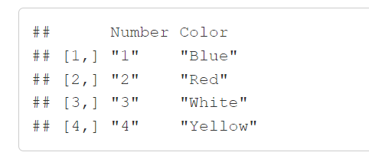
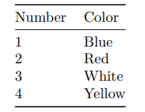
Creating Nice Tables
knitr::kable()
Takes in a data frame or matrix and outputs a nice, formatted table
Can specify the table format, column names, alignment, etc.
Vs.

Slide 10
More Links
Data visualization with R and ggplot2 | the R Graph Gallery
https://www.data-to-viz.com/caveat/declutter.html
https://www.dataviz-inspiration.com/

